Slide 1

RaceJoy Ready
Promotion Toolkit
Please contact us for any additional items for your promotional needs or if you have questions regarding brand guidelines.
©2017. All Rights Reserved.

Slide 2





RaceJoy Graphics, Links and Colors
RaceJoy Website:
www.racejoy.net
RaceJoy Facebook:
https://www.facebook.com/RaceJoy
RaceJoy Twitter:
https://twitter.com/RaceJoy
RaceJoy Tutorial Overview:
http://www.racejoy.com/tour.html
Links to App:
General Download
racejoy.net/download
Apple iTunes:
(Condensed URL)
http://tinyurl.com/me5eftn8
Google Play
(Condensed URL)
http://tinyurl.com/oyv43h4
RaceJoy Colors
Orange: F98E2E
R: 249
G: 142
B: 46
Blue: 1B7DCD
R: 27
G: 125
B: 205
Available in the Apple App Store and Google Play for Android Devices.

Slide 3





Alternative RaceJoy Logos and Icons
Recommended for dark backgrounds or when logo colors blend with your creative.

Slide 4
Most Effective Ways to Drive Awareness Usage
The more people know about RaceJoy, the more they will use it. People are the most engaged the week of the race and this tends to be the most effective time to promote RaceJoy.
However, the sooner you begin letting people know about RaceJoy the more people will begin to use the app and spread the word to their friends and family. All of which helps to promote the race event and sponsor.
These are the top ways to generate awareness that you are offering RaceJoy.
Live Tracking Section on Website
Add a specific section about live tracking and cheer sending in RaceJoy on your website and post RaceJoy’s tutorial. Many events will include the basic How-To content found in this promotion toolkit. This document has lots of helpful information to include under the Race Day area of your site.
Facebook Postings
Dedicate social media posts specifically about RaceJoy versus having it combined with other services and race offerings. The most effective post is the week of the race, but most events will do a RaceJoy post two to three weeks prior to the race to help start driving the usage.
Emails and Upon Registration Confirmation
Sending emails specifically about RaceJoy will help raise awareness. Most will send information as part of the registration confirmation and then two-three weeks prior to race day to generate activity. The week of the race is the most effective time to send an email as this is when people tend to be the most engaged in the race.
This promotion toolkit provides graphics and sample content that you can use for these and other initiatives. If you are in need of any additional promotional items or have questions about promoting RaceJoy, feel free to reach out. We’re happy to help!

Slide 5
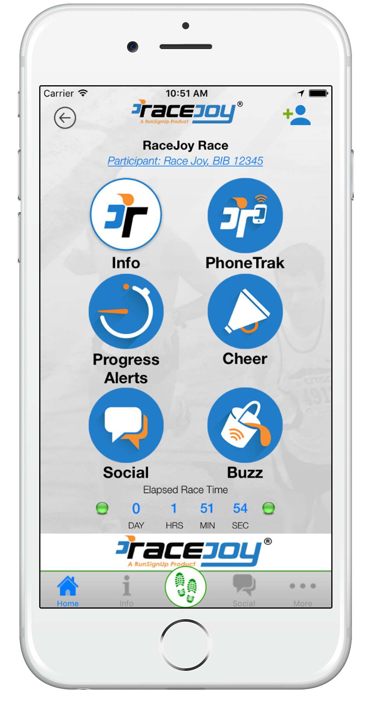
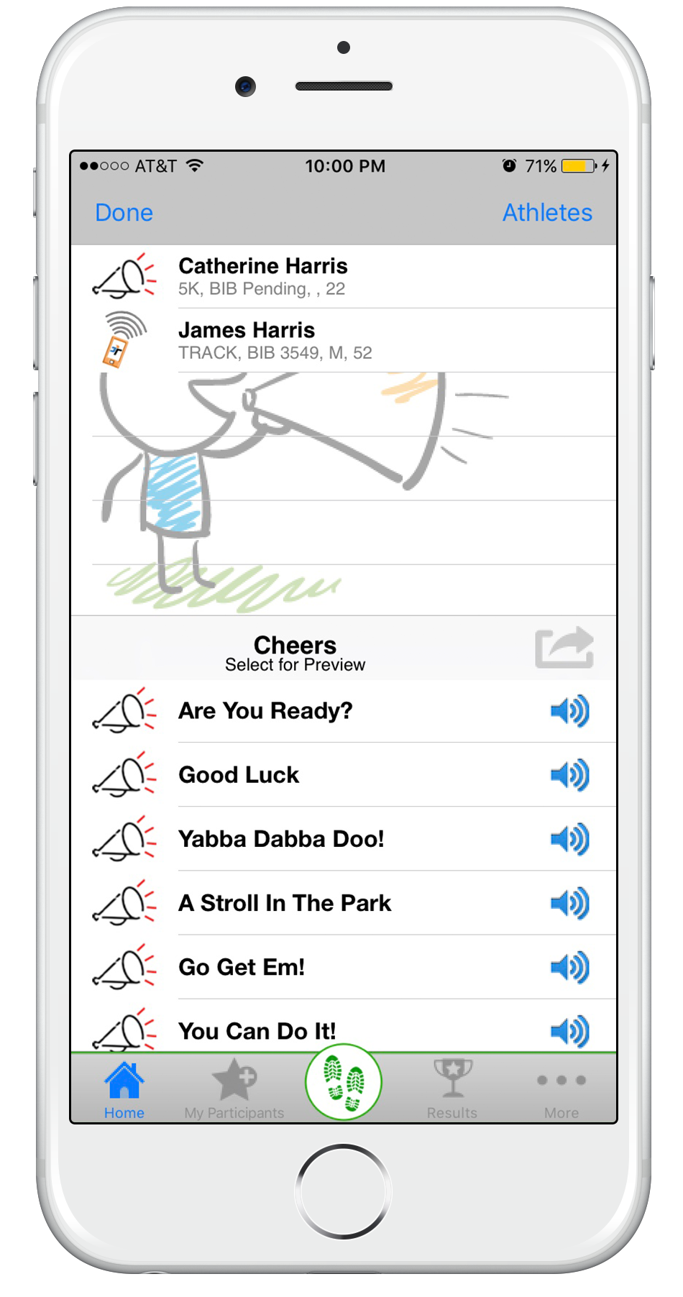
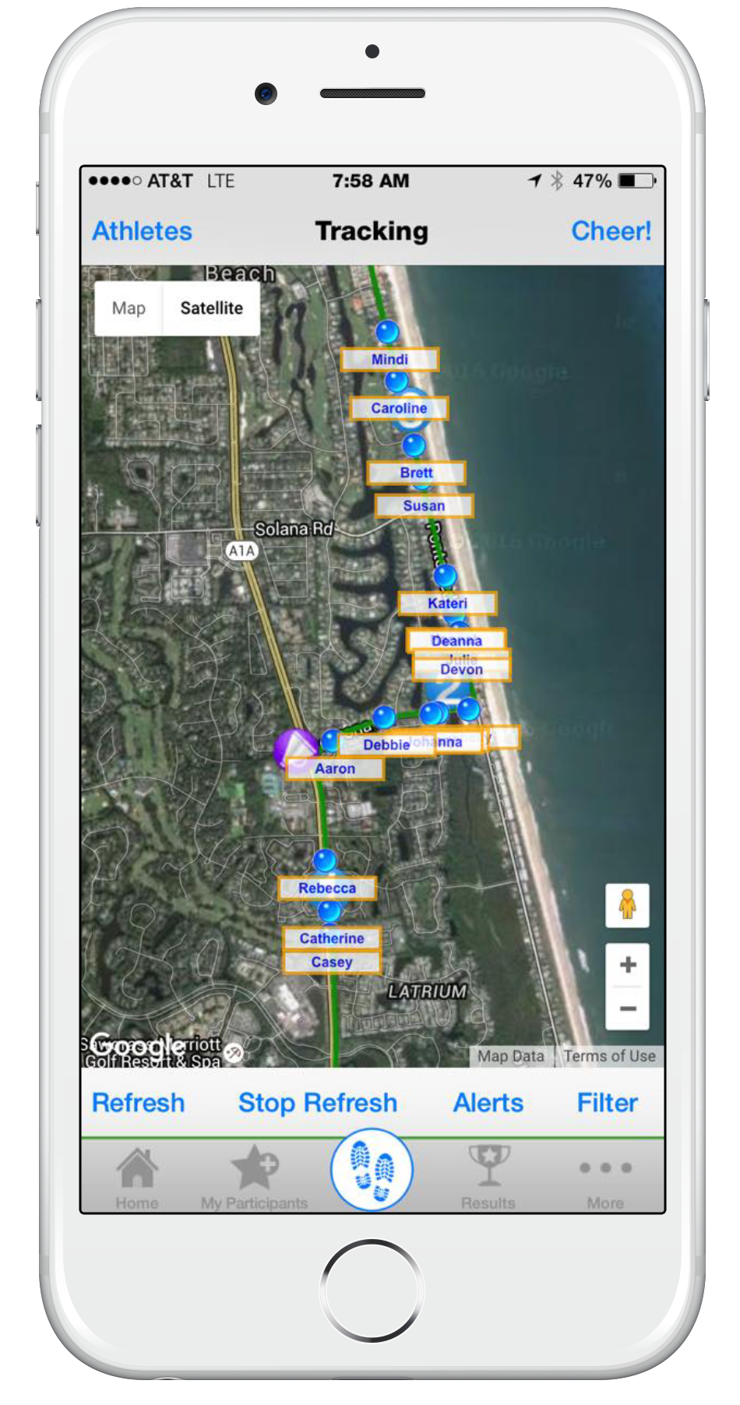
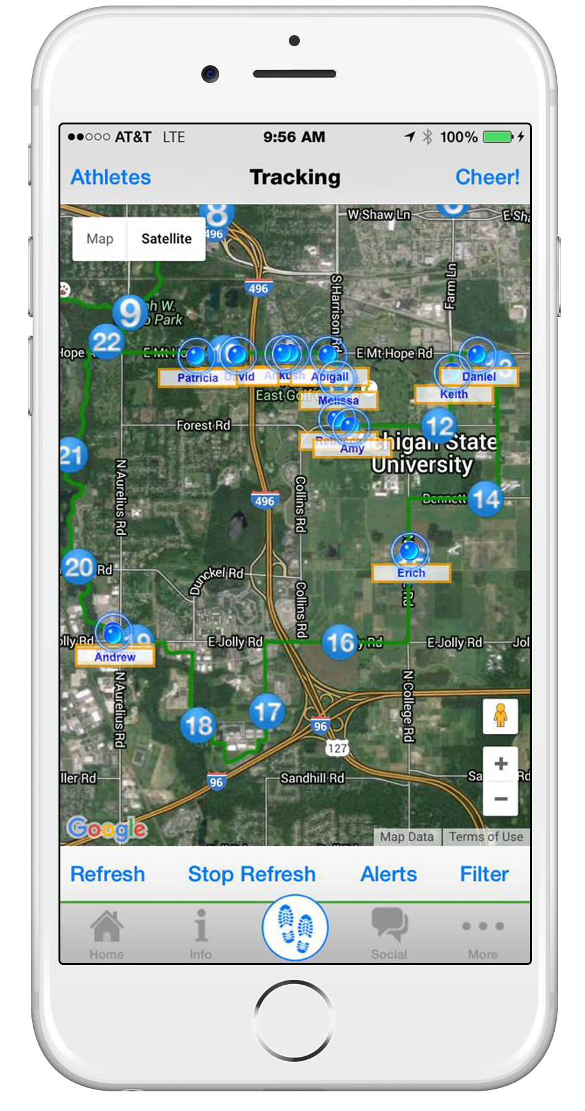
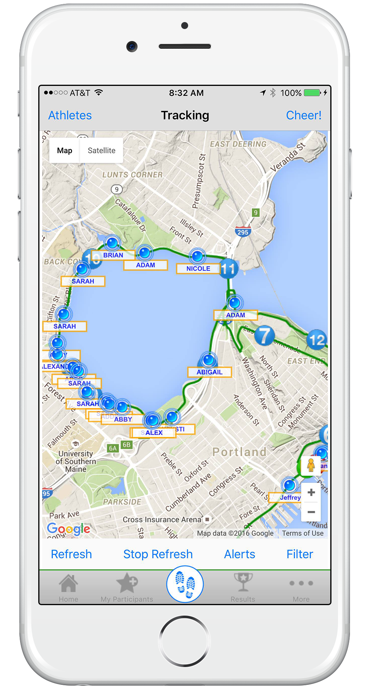
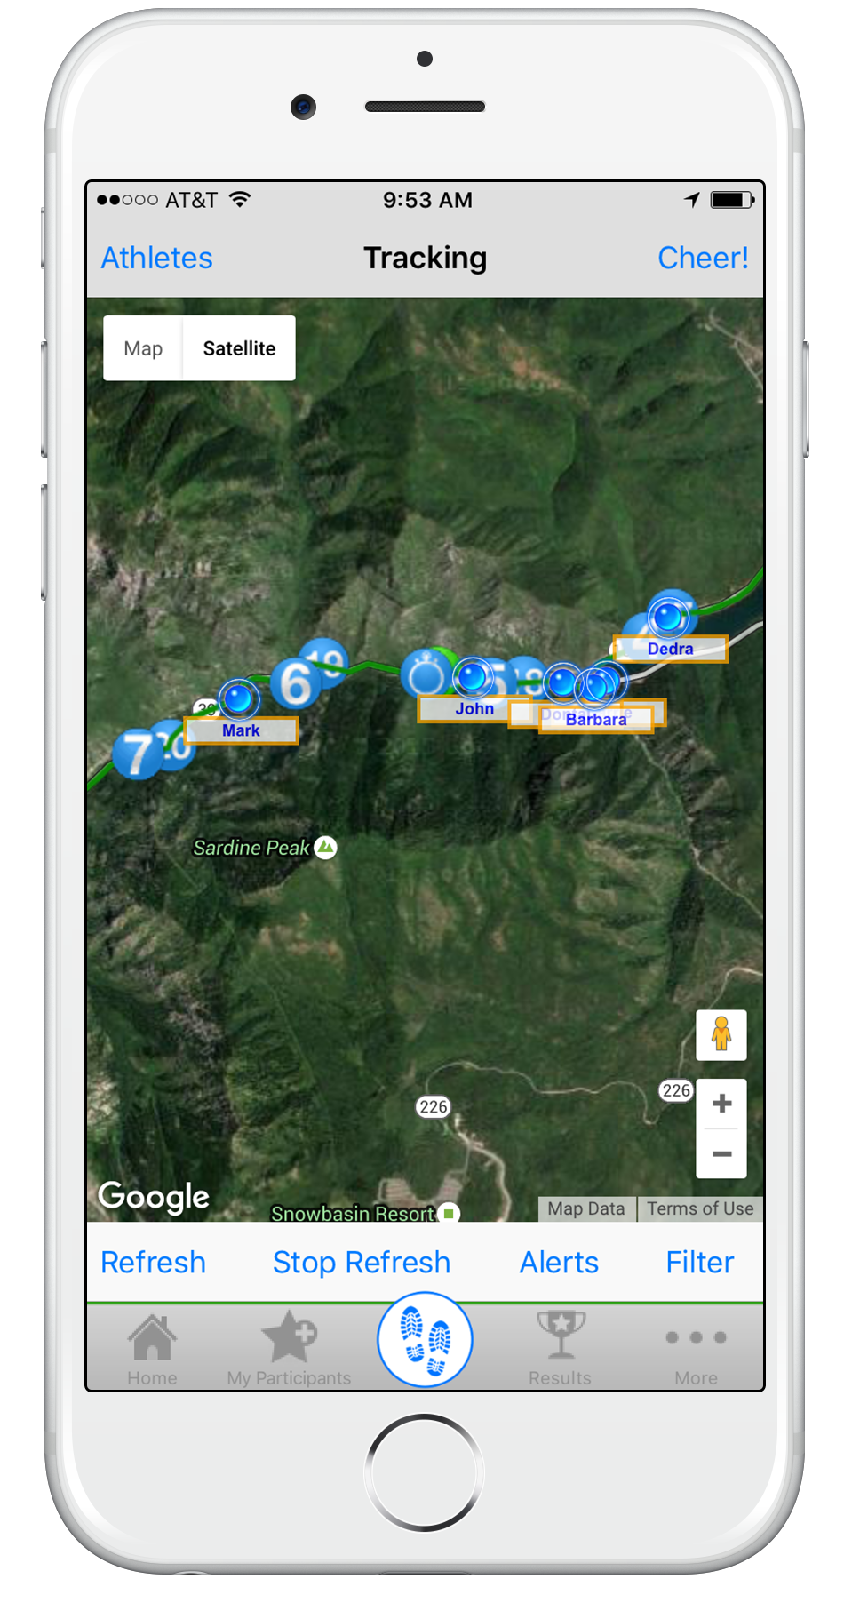
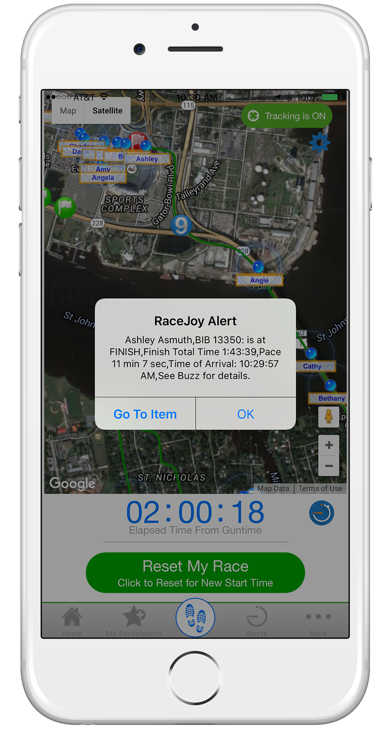
Phone Graphics
Tracking and Progress Alert Graphics

Slide 6
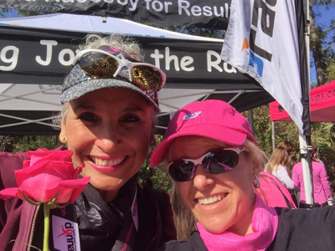
User Tutorial Video
Check out this RaceJoy Overview Video to learn more about the app and the features available to you during this race.
Supplemental
RaceJoy Web Widget:
RaceJoy Battery Tips:
RaceJoy Virtual Ad:
http://racejoy.com/widget.html
http://racejoy.com/assets/docs/BatteryTipsforPhoneFun.pdf
http://racejoy.com/img/promotional_corner/AD.png

Slide 7




Download RaceJoy to Add to Your Race Experience!
Live Phone Tracking!
GPS Based Progress Alerts!
Cheer Sending!
and so much more…
Share your race experience with friends and family!
Download RaceJoy Today!
Questions?
Email: support@racejoy.com
Website: www.racejoy.com
See RaceJoy Buzz Alerts or FAQ in App
Like us on Facebook to see what races are offering RaceJoy!
*RaceJoy is available in the App Store and Google Play.
© All Rights Reserved

Slide 8
Event Materials: Example
Live Phone Tracking, GPS Progress Alerts and Cheers!
Make sure you download the RaceJoy mobile app for Live Runner Tracking at the [Enter Race Name].
Some key RaceJoy features include:
GPS Progress Alerts
Receive continual progress updates as you complete the course! Audio updates are typically sent at every mile and include pace, elapsed time, and estimated finish time.
Option to have progress posted real-time to your Facebook and Twitter walls.
Live GPS Tracking
Supporting spectators can track you live in a map view as your progress along the course. You can track track others as well.
NearMe alerts let spectators know you are drawing near.
Find each other using the MeetUp tool.
Send-a-Cheer
Receive fun, motivational audio cheers from your supporting fans.
Send custom cheers with RaceJoy’s new Text-to-Cheer.
Start sending cheers to others doing the race at any time!
Available for Apple and
Android devices.
Share RaceJoy with your friends and family and ask them to sign in as a spectator. If you carry your phone, they can track you live from home or at the race site.
These interactive race day features are being provided by the race at no charge to you.
Click here for live tracking how-to instructions and our battery preservation tips.
Check out the video below to learn more about the app and the features available to you during this race:
RaceJoy Overview Video

Slide 9
Social Media Posts
Below are sample social media communications that can be used to help promote the RaceJoy App. Feel free to post whatever works best for your event and re-use any of RaceJoy’s posts.
{Announcements}:
Facebook
We are offering free tracking and cheer sending in the RaceJoy mobile App. If you carry your phone during the race, you can receive audio Progress Alerts as you complete the course. These are typically sent out at every mile. Also, people can track your blue dot move on a map and send you fun cheers! Download RaceJoy now to get set up! (Link to App Download)
Twitter
Live tracking avail @[racehandle] in the @RaceJoy mobile app! FREE live phone tracking, GPS progress alerts and fun audio cheers!
{Follow up announcements}:
Facebook
Have you downloaded the RaceJoy mobile app so you can be tracked and receive progress alerts on race day? Make sure to tell your friends & family so they can share in your race experience! You will need to carry your phone and click Start My Race as you cross the start line. This is a free service we are providing to both our participants and their supporting friends and family! (Link to App Download)
Twitter
Use @RaceJoy app for live tracking @[racehandle]! Let friends & family know so they can share in the race experience with you!
RaceJoy Download link:
http://www.racejoy.com/download.html
Use RaceJoy icon to quickly communicate your event is available in RaceJoy.

Slide 10

RaceJoy Live Tracking How-To
Track Me How-To
SetUp
Find Race: Click Featured Races to access the event you are doing.
Set Up Phone for Tracking: Click "I Want To Be Tracked" and follow the prompts carefully. If you are one of the few races where Bib Tag tracking is being offered in RaceJoy, you will need to click the PhoneTrak button to set up your phone.
Track Others: You can track up to 50 people by clicking on the participant icon on the upper part of the screen. Relay Teams need to add ALL team members to their list to receive team progress alerts.
Plan to Carry Your Phone: Participants must carry their phone during the race.
Race Day
Turn Tracking On: Click the green blinking button on Race Day. Tracking is activated 30 minutes before the race start time.
Click: Click START MY RACE/LEG as you cross the START LINE/LEG for more accurate progress alerts. This is optional. If you do not click START MY RACE, your start time will be based on mile one.
Relay Teams: select the leg you are completing and wait to click START MY LEG until you begin your leg. The first leg MUST click START MY LEG to receive team progress alerts.
Replay Race Day in Buzz: Click Buzz to review your alerts and replay cheers!
Note: You must access RaceJoy on race day to activate GPS tracking. If you do not click START MY RACE, RaceJoy will base your start time on when you reach mile one.
Warning: Turn OFF Wi-Fi on race day. This will cause tracking to disengage.
Track Others How-To
Add participants to your participants list:
  Click on the icon on the upper corner of your screen and search for your participant.
Track them in a map view:
  Apple Users: click the feet icon at the bottom of the screen.
  Android Users: click the Track button at the top menu bar.
Track them with GPS-based progress alerts:
  You will automatically receive these once you've added people to your participant list.
  Click Buzz and then Progress Alerts to view alerts received.
  The number of alerts vary by race and are typically sent out at every mile.
  Make sure you have your Notifications ON and your volume up to receive alerts.
Relay Team How-To
Team Set Up:
  All need to click "I Want to Be Tracked" upon initial set up. Follow the prompts.
  Select "Relay Course" option in course selection section. You may need to scroll down the course option list.
  Sign up with team or add team to list, if not shown. Make sure to select the correct team as many team names are similar.
  Add ALL team members to your participant list (this is required to receive team progress alerts).
Race Day: Select & Start Leg:
  Select Leg: Select the leg you are going to complete.
  Wait to click START MY LEG until you actually begin your leg. This begins the personal race time for that leg.
  If you are doing more than one leg, you will need to select each leg and click "Start My Leg" as you begin each segment.
  If you do not click START MY LEG, then GPS tracking will still be available as long as you turn your tracking on. You just will not receive progress alerts for that segment.
Verify Proper Team Set Up:
Click the More button on race page in RaceJoy.
Click Profile: If you do not see your team name at the top of the screen, redo your setup by clicking your name and following the Team Set Up steps above.
Watch Overview Video
See Battery Preservation Tips
No Guarantee: RaceJoy is bringing together multiple technologies to deliver advanced tracking and interactive experiences during the race. There are many variables that affect RaceJoy's ability to function properly and there is no guarantee RaceJoy will function for a given user. Factors that may affect RaceJoy include older phone models, improper phone set up, weak cell signals in a given region, participant's use of Wi-Fi, unexpected course changes, etc. If you experience any issues, please contact us at support@racejoy.com.

Slide 11

www.racejoy.com

