Slide 1

RaceJoy Ready
Promotion Toolkit
©2020. All Rights Reserved.

Slide 2





RaceJoy Graphics, Links and Colors
RaceJoy Website:
www.racejoy.net
RaceJoy Facebook:
https://www.facebook.com/RaceJoy
RaceJoy Twitter:
https://twitter.com/RaceJoy
RaceJoy Tutorial Overview:
http://www.racejoy.com/tour.html
Links to App:
General Download
racejoy.net/download
Apple iTunes:
(Condensed URL)
http://tinyurl.com/me5eftn8
Google Play
(Condensed URL)
http://tinyurl.com/oyv43h4
RaceJoy Colors
Orange: F98E2E
R: 249
G: 142
B: 46
Blue: 1B7DCD
R: 27
G: 125
B: 205
Available in the Apple App Store and Google Play for Android Devices.

Slide 3





Alternative RaceJoy Logos and Icons
Recommended for dark backgrounds or when logo colors blend with your creative.

Slide 4
Most Effective Ways to Drive Awareness Usage
The sooner you begin letting people know about RaceJoy the more people will begin to use the app and spread the word to their friends and family. All of which helps to promote the race event and sponsor.
As part of your messaging we recommend communicating RaceJoy is where you will provide your official virtual race experience where participants can feel connected and many of the unique aspects that make a race experience (results, cheer sending, support along the virtual “course”). If you are adding custom sound files to play at distance points or along the course, make sure to let participants know you are offering an audio experience.
These are the top ways to generate awareness that you are offering RaceJoy.
Live Tracking Section on Website
Add a specific section about live tracking and cheer sending in RaceJoy on your website and post RaceJoy’s how-to piece found in this promotion toolkit. This document has lots of helpful information to include under the Race Day area of your site.
Facebook Postings
Dedicated social media posts specifically about RaceJoy versus having it combined with other services and race offerings is very effective. Showing photos or mini video clips of the blue dots on your monitoring dashboard of runners is a great way to draw interest.
Emails and Upon Registration Confirmation
Sending emails specifically about RaceJoy will help raise awareness. Most will send information as part of the registration confirmation and then two-three weeks prior to the event day or start of a virtual race to generate activity. RunSignup races automatically issue informative emails about RaceJoy.
This promotion toolkit provides graphics and sample content that you can use for these and other initiatives. If you are in need of any additional promotional items or have questions about promoting RaceJoy, feel free to reach out. We’re happy to help!

Slide 5
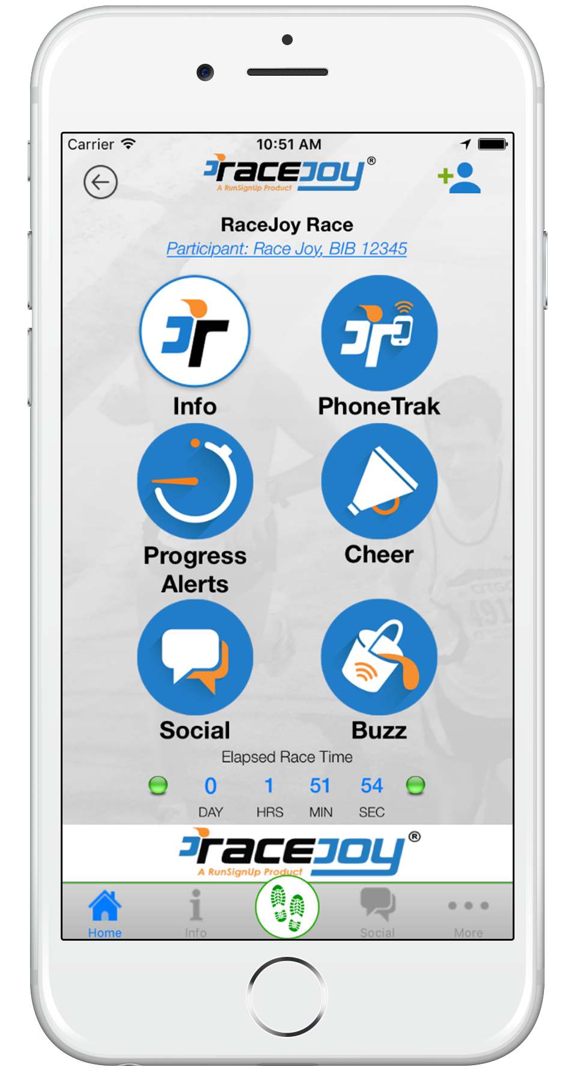
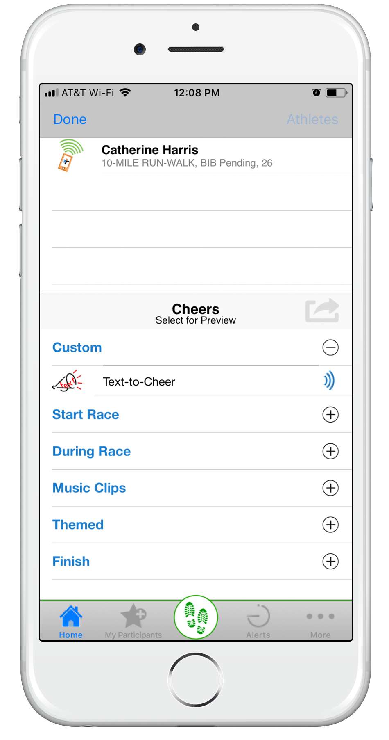
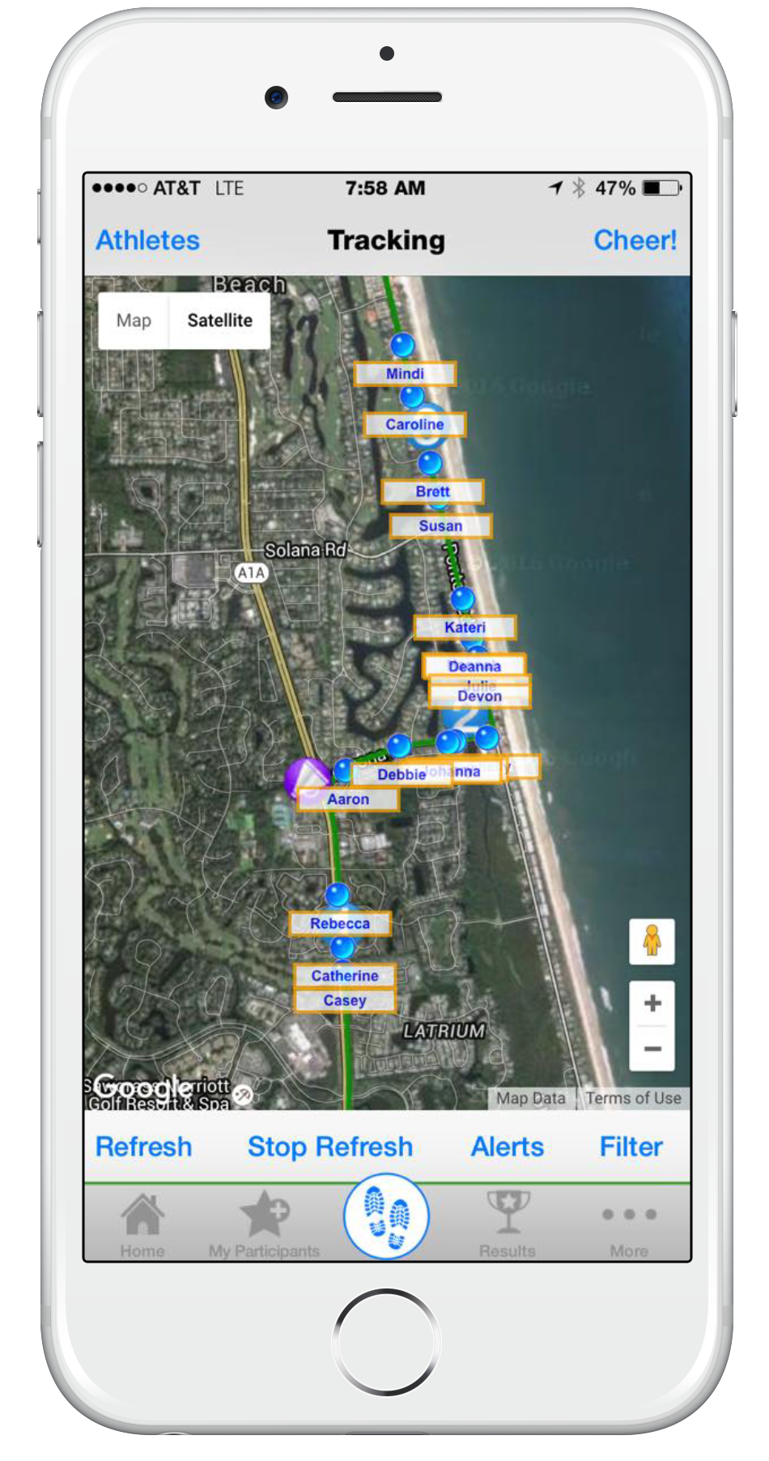
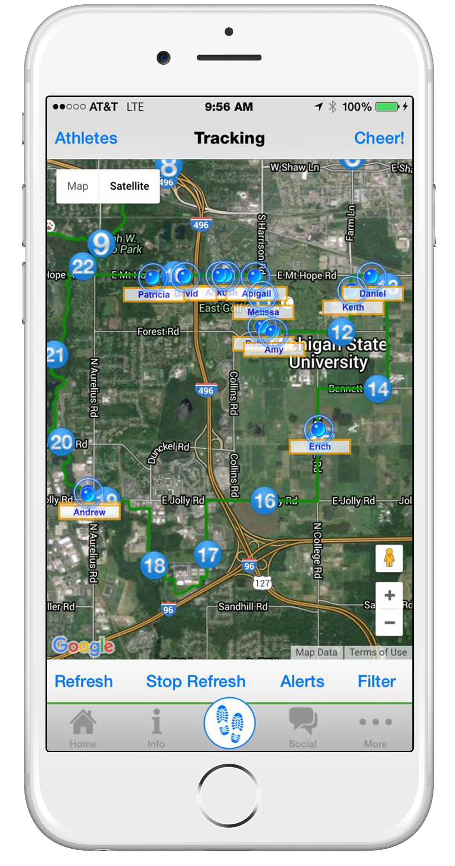
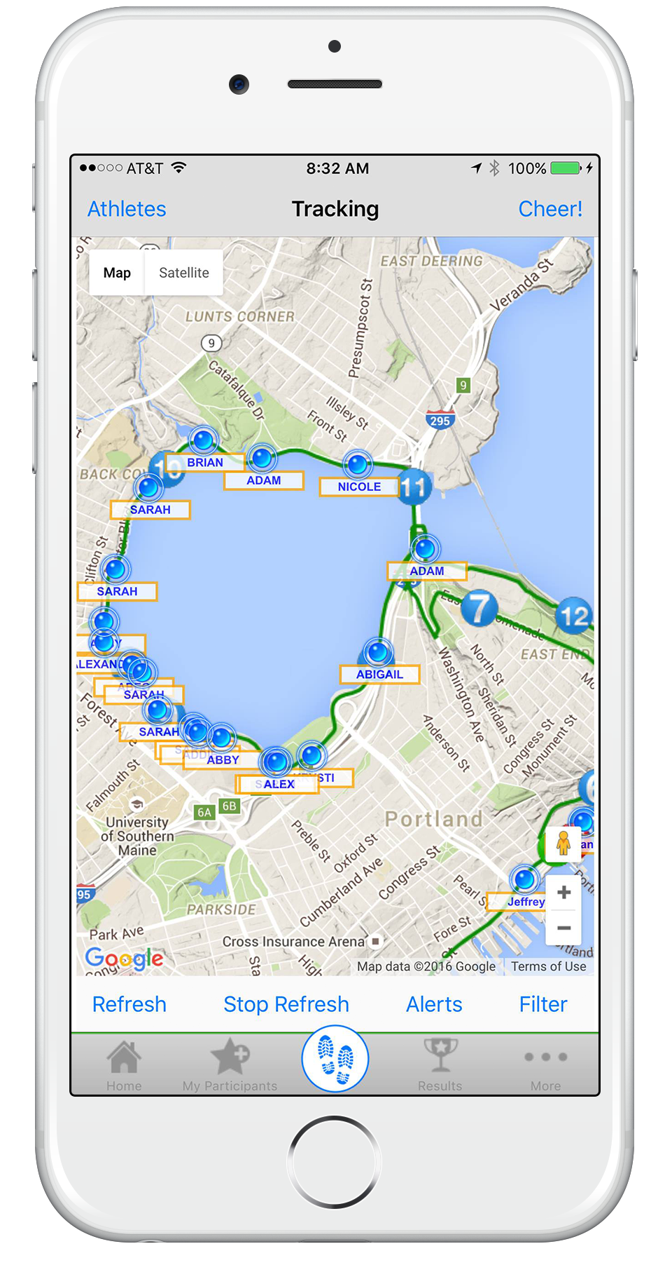
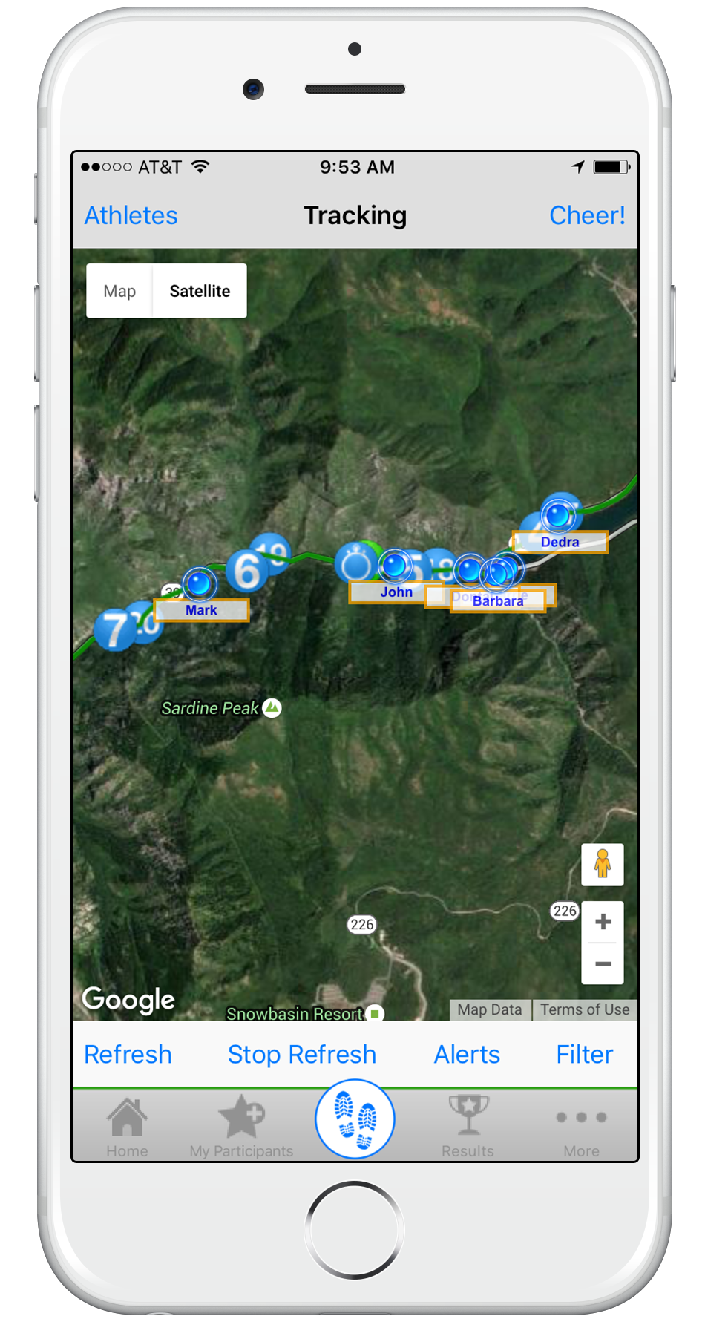
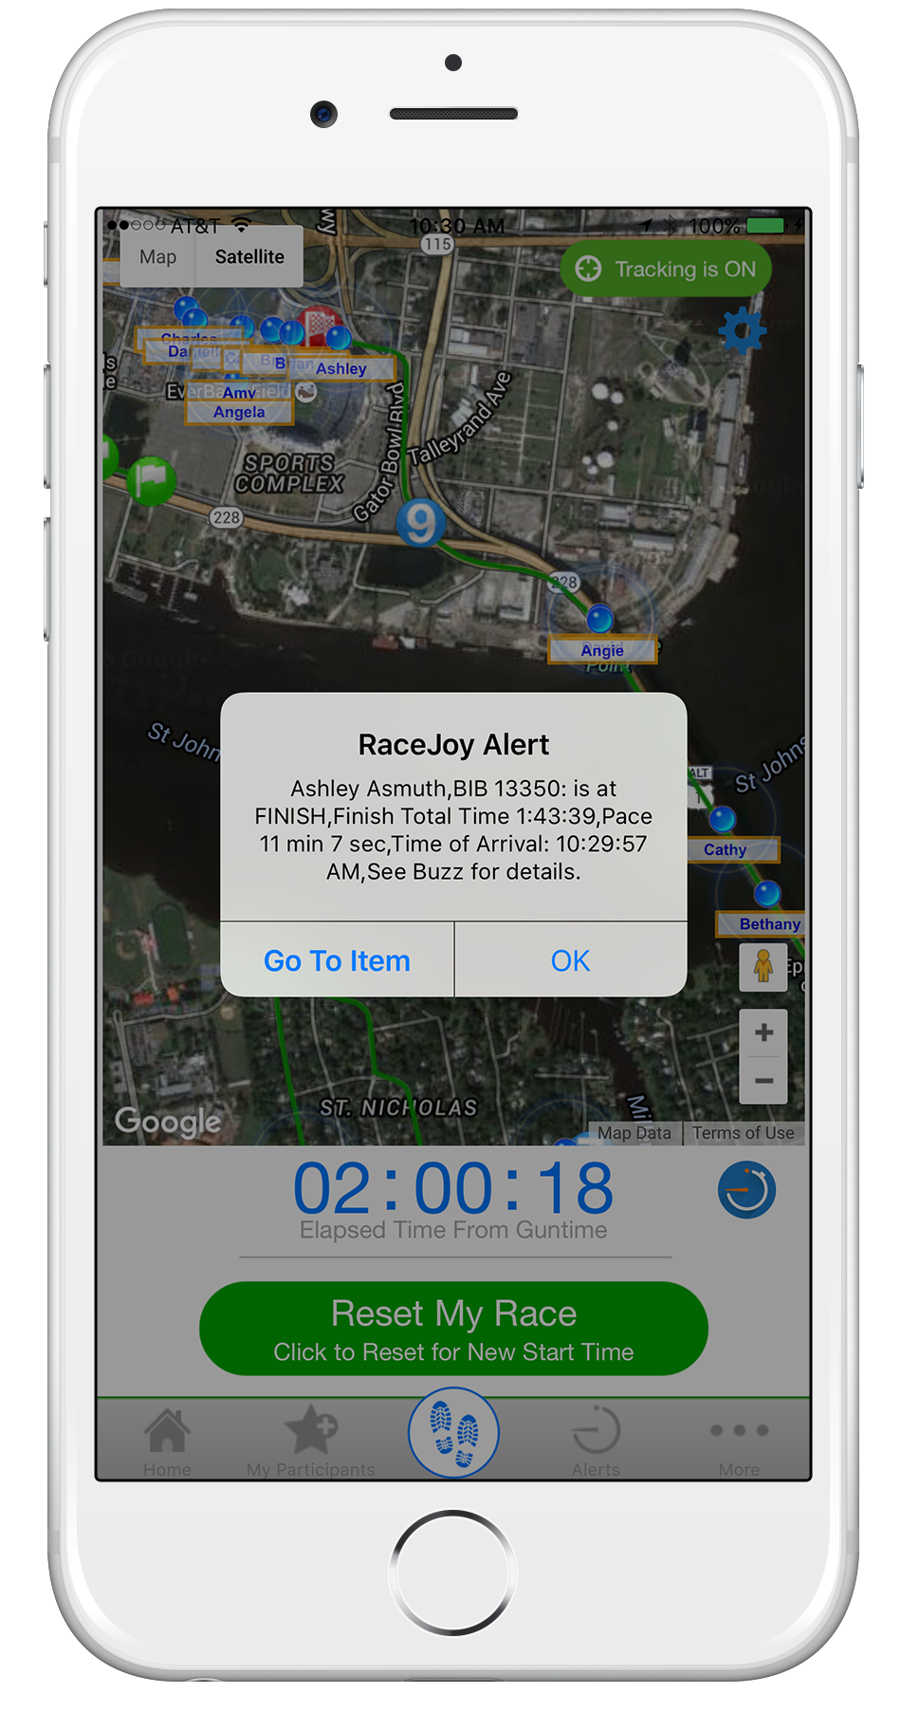
Phone Graphics
Tracking and Progress Alert Graphics

Slide 6
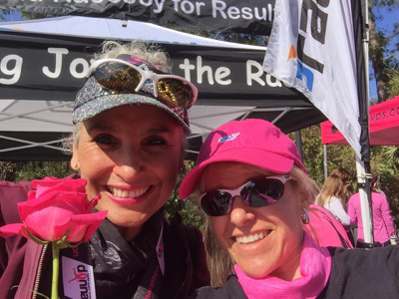
User Tutorial Video
Check out this RaceJoy Overview Video to learn more about the app and the features available to you during this race.
Battery Tips
RaceJoy Battery Tips:
http://racejoy.com/assets/docs/BatteryTipsforPhoneFun.pdf

Slide 7

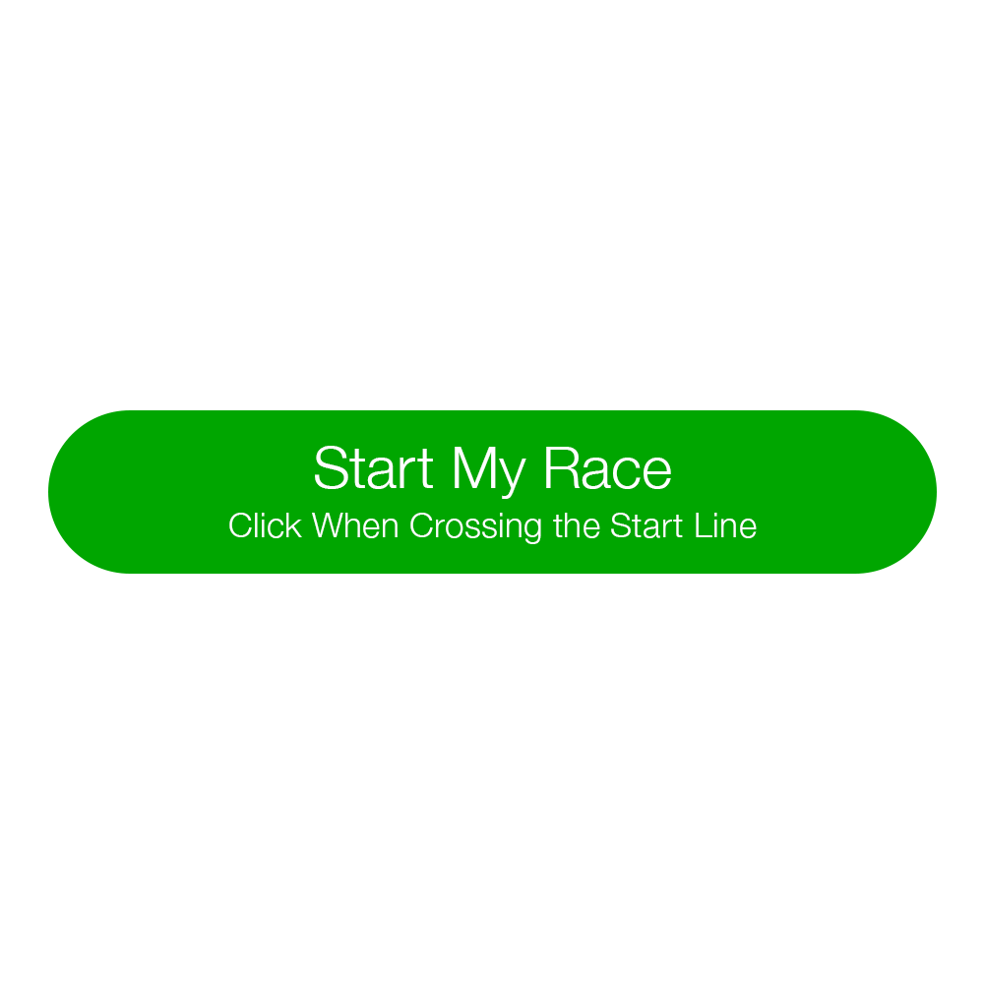

RaceJoy Virtual Race
Tracking How-To
1
Download RaceJoy: Download the RaceJoy app to your phone from the App Store or GooglePlay.
Find Race: Click Featured Races and then access your event. Or search by race name in search field.
Phone Setup: Follow the prompts carefully to get set up properly for race day.
RaceDay: Turn tracking ON in RaceJoy and click Start My Race to begin your personal race clock.
2
3
4
Set Up
Race Day
Click the “I Want to Be Tracked” button upon initial setup. Follow the prompts and select the course(s) you plan to complete.
Adjust your audio settings to your personal preferences. Recommend turning off progress alerts, if using training app.
Participants must carry their phones and turn on tracking the day of their race for tracking to function.
There is no personal pre-loading of maps required for RaceJoy.
Turn tracking on by clicking the green, blinking button on your Race Day.
Select the course you are about to begin.
Click START MY RACE as you begin to start your personal clock. For on-site courses: Click this as you cross the START LINE. This is optional for on-site courses- but it provides a more accurate finish time.
RaceJoy auto detects when you finish the distance selected. No need to click finish button.
Virtual Results & Race Redo
Automated Virtual Results - Available for most virtual races in RaceJoy.
Enter the Bib number provided to you by the race to have your RaceJoy finish data automatically submitted for scored results.
Race Redo - You can redo the distance or onsite route to submit a new finish time.
Select the Redo button to re-complete the distance. Warning: This will erase previous performance data.
Track Yourself and Up to 50 People
Add participants: Click the icon on the upper corner of your screen and search for your participant.
Track in a map view: Apple Users: click the feet icon at the bottom of the screen. Android Users: click the Track button at the top menu bar.
Track with GPS-based progress alerts:
  The number of alerts vary by race and are typically sent out at every mile.
  You will automatically receive audio updates for yourself and notifications for those you track.
  Click Buzz and then Progress Alerts to view progress alerts for yourself and those you have tracked.
  Make sure you have your Notifications ON and your volume up to receive alerts.
Questions: see in-app FAQ, RaceJoy website, or email support@racejoy.com

Slide 8



Download RaceJoy for an Interactive
Virtual Race Experience!
Live Phone Tracking
GPS-Based Progress Alerts
Remote Cheer Sending
Virtual Scored Results
Don’t Race Alone
Download RaceJoy Today!
Questions?
Email: support@racejoy.com
Website: www.racejoy.com
See RaceJoy Buzz Alerts or FAQ in App
*RaceJoy is available in the App Store and Google Play.
© All Rights Reserved

Slide 9
Download RaceJoy for an Interactive
Virtual Race Experience!
Live Phone Tracking
GPS-Based Progress Alerts
Remote Cheer Sending
Virtual Scored Results
Plus!
<Race Name> Surprise Audio Experience
Don’t Race Alone
Download RaceJoy Today!
Questions?
Email: support@racejoy.com
Website: www.racejoy.com
See RaceJoy Buzz Alerts or FAQ in App
*RaceJoy is available in the App Store and Google Play.
© All Rights Reserved

Slide 10
Event Materials: Example
Interactive Race Day Experience with RaceJoy
Live Phone Tracking, GPS Progress Alerts and Cheers!
We are taking our virtual event to the next level by providing you with RaceJoy’s interactive, socially safe race experience.
Make sure you download the RaceJoy mobile app in advance to ensure proper phone setup.
Some key RaceJoy features include:
GPS Progress Alerts
Receive continual progress updates as you complete your goal.
Live GPS Tracking
Remote spectators can track you live in a map view as your progress along the course. You can track track others as well.
Send-a-Cheer
Receive supportive audio cheers from remote friends & family.
Virtual Results
Enter your race bib number to automatically submit your finish data for real-time scored results.
Available for Apple and
Android devices.
These interactive race day features are being provided by the race at no charge to you. You must carry your phone as you complete your virtual race and click the Start My Race button in RaceJoy to begin your personal clock. There is no need to load in course maps or pre-set up your spectators.
Click here for live tracking how-to instructions and our battery preservation tips.
Check out the video below to learn more about the app and the features available to you during this race:
RaceJoy Overview Video

Slide 11
Social Media Posts
Below are sample social media communications that can be used to help promote the RaceJoy App. Feel free to post whatever works best for your event.
{Announcements}:
Facebook
No need to race alone! We are taking our virtual race to the next level with RaceJoy’s interactive, socially safe mobile race day. Download the RaceJoy app and carry your phone as you complete your chosen distance. You’ll receive official race progress alerts and people can track your position – including us, the race organizers! Your friends and family can send you fun audio cheers without concern for social distancing. Plus, if you add in your bib number, your finish time will automatically submit and we will deliver up real-time scored results. Download RaceJoy now to get set up! (Link to App Download)
Twitter
Don’t race alone! We are taking things to the next level with RaceJoy’s interactive, socially safe virtual race experience. Live tracking, remote cheers, progress alerts, virtual results. All free. Carry phone. Download @RaceJoy now.
RaceJoy Download link:
http://www.racejoy.com/download.html
Use RaceJoy icon to quickly communicate your event is available in RaceJoy.

Slide 12

www.racejoy.com

